Slide 1

Network Science
The scale-free property
Dr. Tamás Orosz
Ph.D., habil.
Lecture 5, 10/10/2024

Slide 2
THE SCALE-FREE PROPERTY
World Wide Web:
a network whose nodes are documents and the links are the uniform resource locators (URLs) that allow us to “surf” with a click from one web document to the other.
Importance of the World Wide Web:
WWW played in the development of network theory: it facilitated the discovery of a number of fundamental network characteristics and became a standard testbed for most network measures.
Network Science, 10/19/2023

Slide 3
CRAWLER
A software called a crawler can be used to map out the Web’s wiring diagram.
A crawler can start from any web document, identifying the links (URLs) on it. Next it downloads the documents these links point to and identifies the links on these documents, and so on. This process iteratively returns a local map of the Web. Search engines like Google or Bing operate crawlers to find and index new documents and to maintain a detailed map of the WWW.
The purpose of the map was to compare the properties of the Web graph to the random network model. Indeed, in 1998 there were reasons to believe that the WWW could be well approximated by a random network.
Network Science, 10/19/2023

Slide 4
Differences between real and random network
In a random network highly connected nodes, or hubs, are effectively forbidden.
In contrast, in the Figure numerous small-degree nodes coexist with a few hubs, nodes with an exceptionally large number of links.
Network Science, 10/19/2023

Slide 5
DEGREE DISTRIBUTION OF REAL NETWORKS
Hubs are not unique to the Web, but we encounter them in most real networks. They represent a signature of a deeper organizing principle that we call the scale-free property.
No matter what network property we are interested in, from communities to spreading processes, it must be inspected in the light of the network’s degree distribution.
Network Science, 10/19/2023

Slide 6
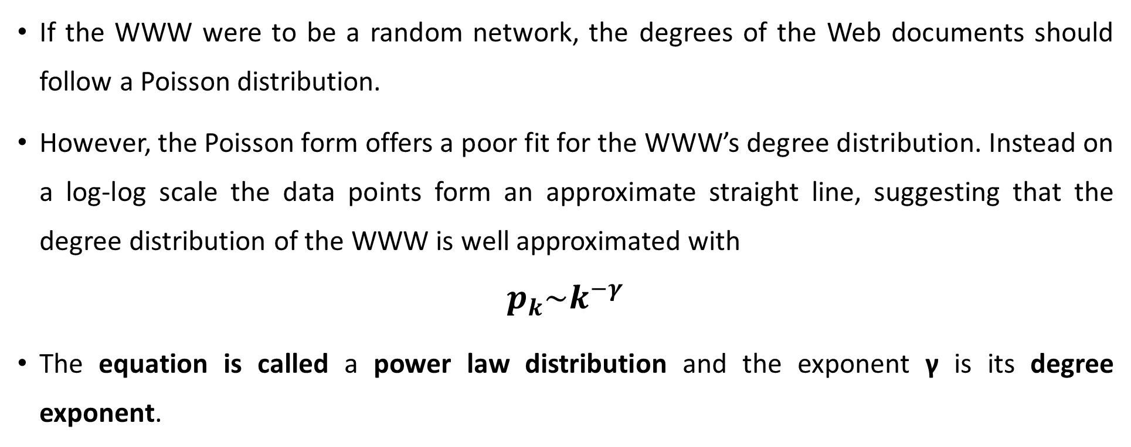
POWER LAWS AND SCALE-FREE NETWORKS
If the WWW were to be a random network, the degrees of the Web documents should follow a Poisson distribution.
However, the Poisson form offers a poor fit for the WWW’s degree distribution. Instead on a log-log scale the data points form an approximate straight line, suggesting that the degree distribution of the WWW is well approximated with
$$p_{k}\sim k^{−γ}$$
The equation is called a power law distribution and the exponent γ is its degree exponent.
Network Science, 10/19/2023

Slide 7
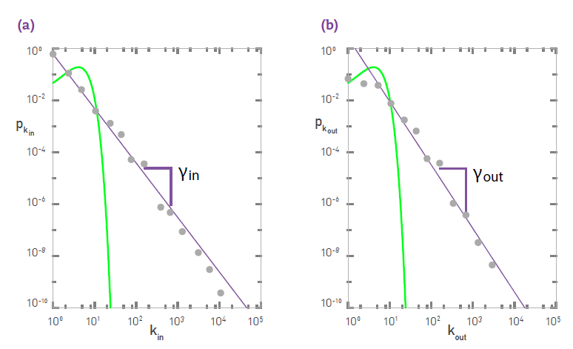
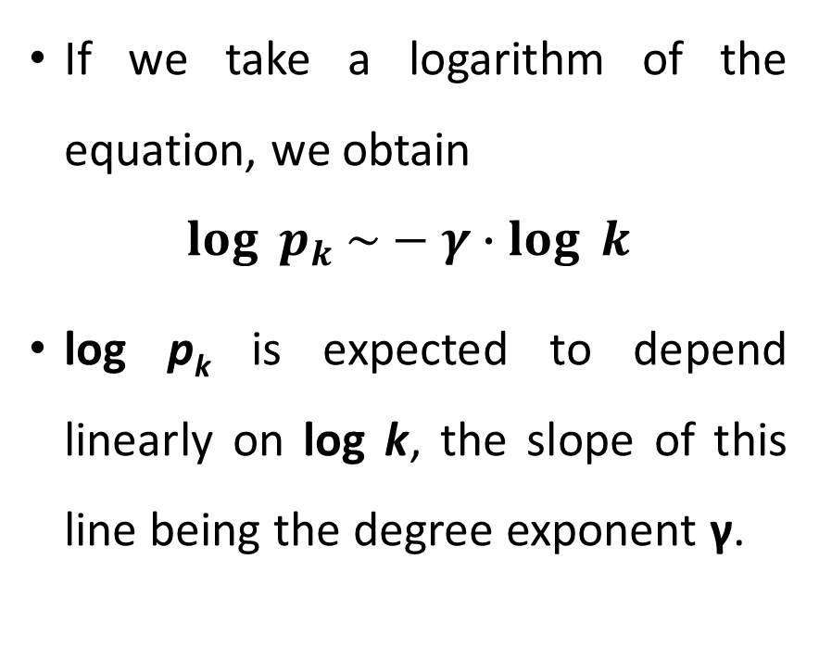
Logarithm plot
If we take a logarithm of the equation, we obtain
$$\log_{ }{p_{k} \sim }−{γ∙log}_{ }{k}$$
log p_{k} is expected to depend linearly on log k, the slope of this line being the degree exponent γ.
Network Science, 10/19/2023

Slide 8
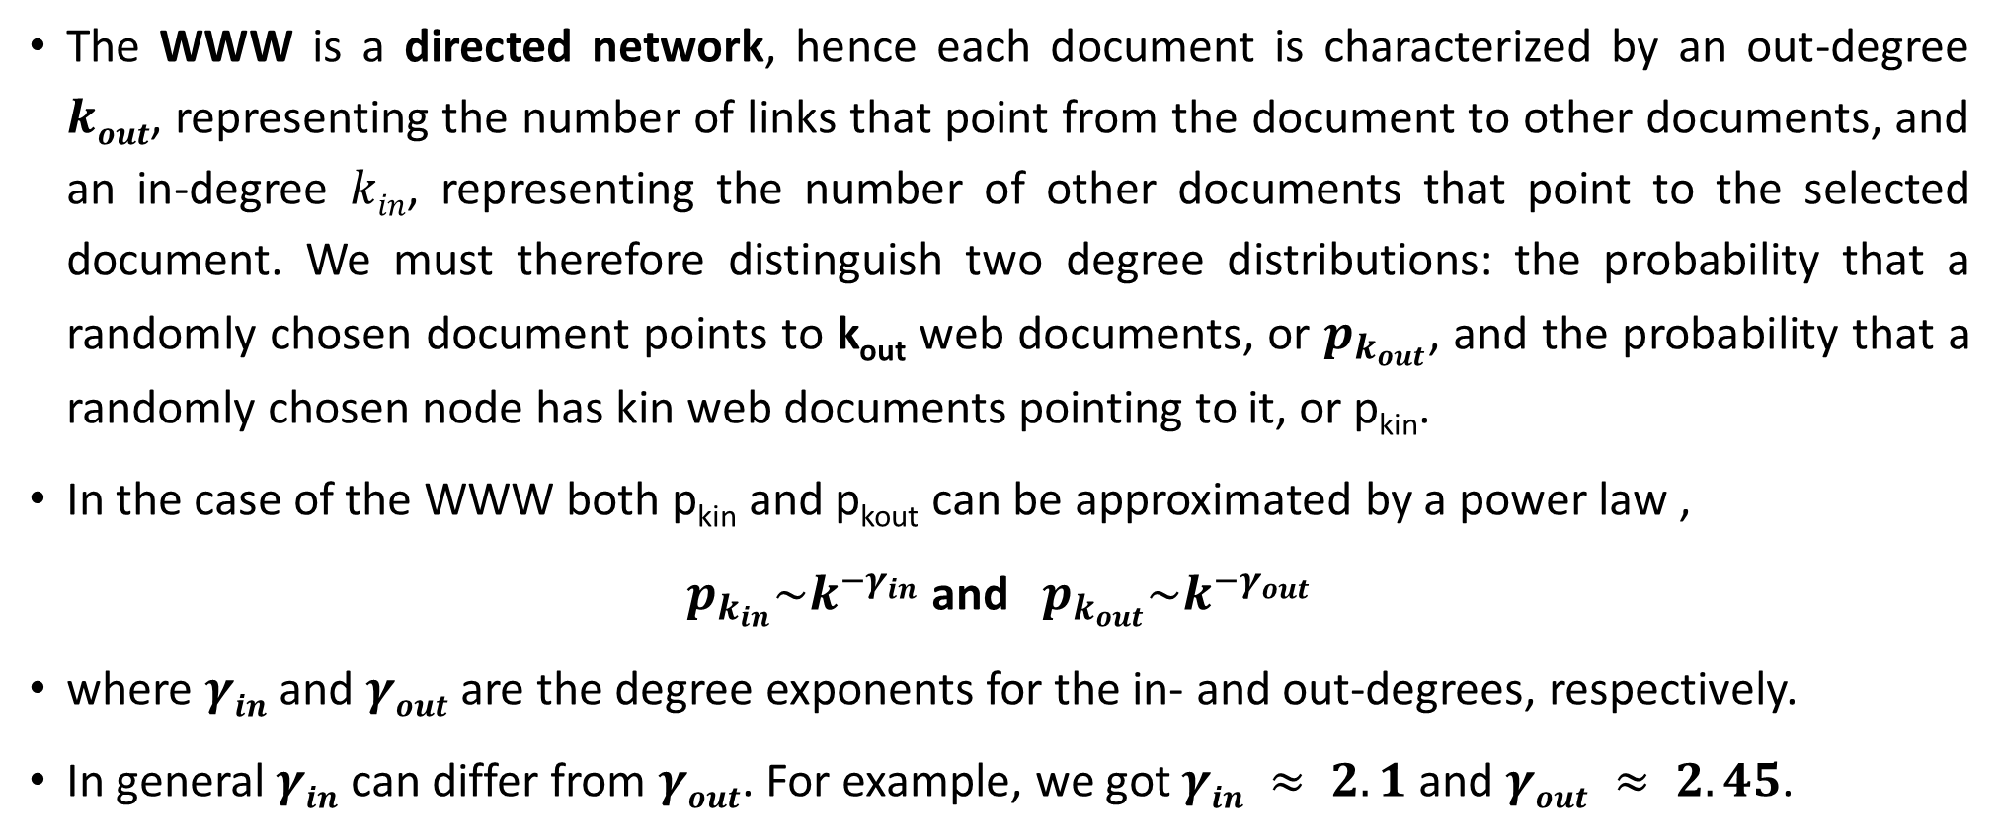
in-degree and out-degree
The WWW is a directed network, hence each document is characterized by an out-degree $kout$, representing the number of links that point from the document to other documents, and an in-degree $kin$, representing the number of other documents that point to the selected document. We must therefore distinguish two degree distributions: the probability that a randomly chosen document points to k_{out} web documents, or $p_{k_{out}}$, and the probability that a randomly chosen node has kin web documents pointing to it, or p_{kin}.
In the case of the WWW both p_{kin} and p_{kout} can be approximated by a power law ,
$p_{k_{in}}\sim k^{{−γ}_{in}}$ and $p_{k_{out}}\sim k^{{−γ}_{out}}$
where $γin$ and $γout$ are the degree exponents for the in- and out-degrees, respectively.
In general $γin$ can differ from $γout$. For example, we got $γin ≈ 2.1$ and $γout ≈ 2.45$.
Network Science, 10/19/2023

Slide 9
Definition of the scale-freee network
The empirical results document the existence of a network whose degree distribution is quite different from the Poisson distribution characterizing random networks.
We will call such networks scale-free, defined as:
A scale-free network is a network whose degree distribution follows a power law.
Network Science, 10/19/2023

Slide 10
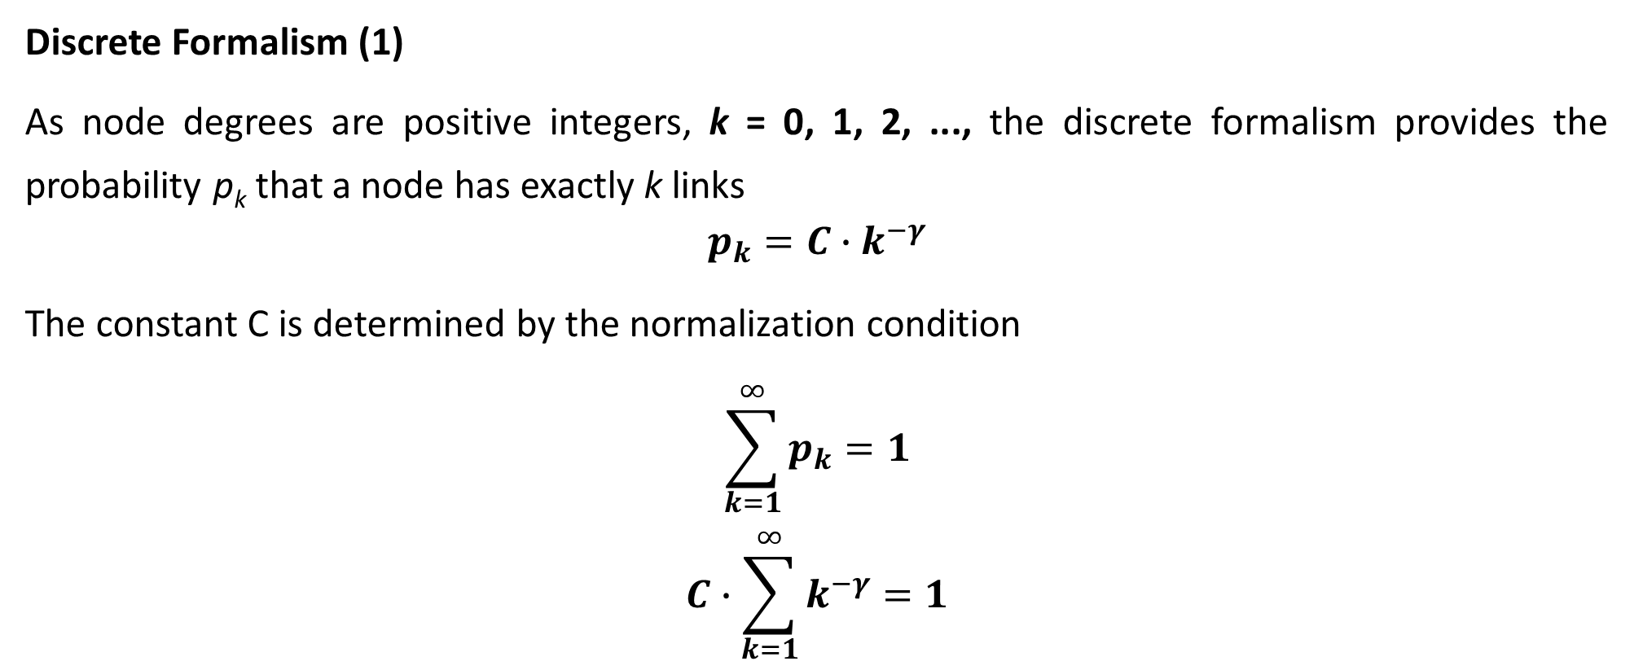
Discrete and the continuum formalisms of power-law distribution
Discrete Formalism (1)
As node degrees are positive integers, k = 0, 1, 2, ..., the discrete formalism provides the probability p_{k} that a node has exactly k links
$$p_{k}=C∙k^{−γ}$$
The constant C is determined by the normalization condition
$$\sum_{k=1}^{∞}{p_{k}=1}$$
$$C∙\sum_{k=1}^{∞}{k^{−γ}=1}$$
Network Science, 10/19/2023

Slide 11

Discrete Formalism (2)
$$C=\frac{1}{\sum_{k=1}^{∞}{k^{−γ}}}=\frac{1}{ξ\left(γ\right)}$$
where $ξ\left(γ\right)$is the Riemann-zeta function. Thus for $k > 0$ the discrete power-law distribution has the form
$$p_{k}=\frac{k^{−γ}}{ξ\left(γ\right)}$$
Network Science, 10/19/2023

Slide 12
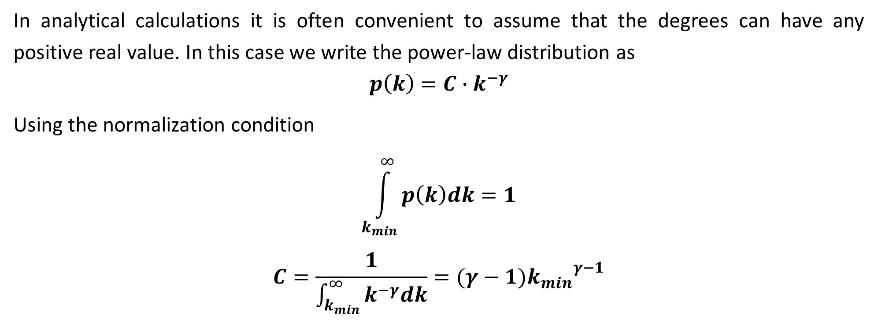
Continuum formalism
In analytical calculations it is often convenient to assume that the degrees can have any positive real value. In this case we write the power-law distribution as
$$p\left(k\right)=C∙k^{−γ}$$
Using the normalization condition
$$\int_{k_{min}}^{∞}{p\left(k\right)dk=1}$$
$$C=\frac{1}{\int_{k_{min}}^{∞}{k^{−γ}dk}}=(γ−1){k_{min}}^{γ−1}$$
Network Science, 10/19/2023

Slide 13
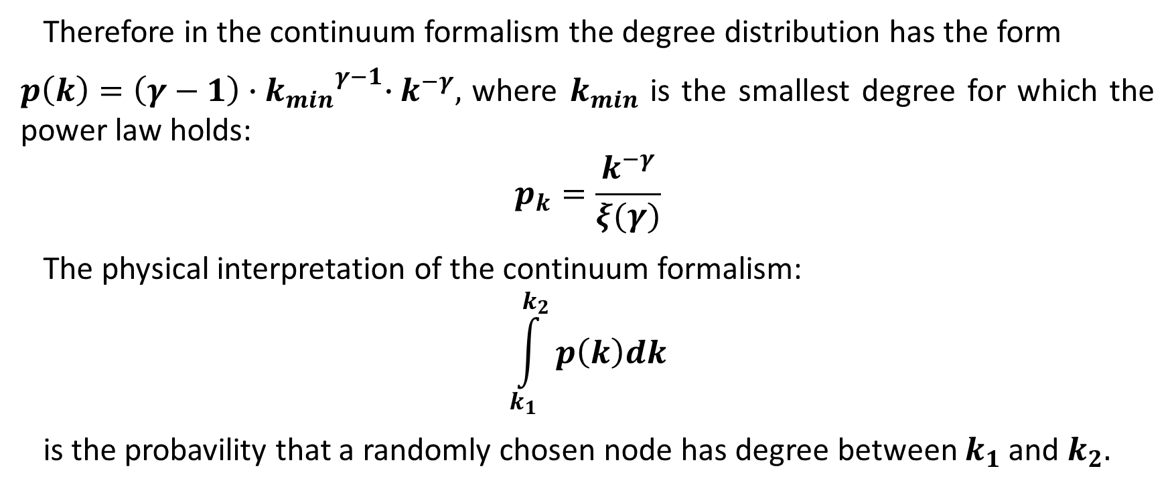
Continuum formalism (2)
Therefore in the continuum formalism the degree distribution has the form
$p\left(k\right)=\left(γ−1\right){{∙k}_{min}}^{γ−1}∙k^{−γ},$ where $k_{min}$ is the smallest degree for which the power law holds:
$$p_{k}=\frac{k^{−γ}}{ξ(γ)}$$
The physical interpretation of the continuum formalism:
$$\int_{k_{1}}^{k_{2}}{p\left(k\right)dk}$$
is the probavility that a randomly chosen node has degree between $k_{1}$ and $k_{2}.$
Network Science, 10/19/2023

Slide 14
In summary, networks whose degree distribution follows a power law are called scale-free networks. If a network is directed, the scale-free property applies separately to the in- and out-degrees. To mathematically study the properties of scale-free networks, we can use either the discrete or the continuum formalism. The scale-free property is independent of the formalism we use.
Network Science

